Slide 1
Unit 5
Application of Data Warehousing and Data Mining in Government

Slide 2
Introduction
Data warehousing and data mining are the important means of preparing the government to face the challenges of the new millennium.
Data warehousing and data mining technologies have extensive potential applications in the government in various Central Government Sectors such as Agriculture, Rural Development, Health and Energy and also in state Government activities.
Data warehousing and data mining are best suited for number of applications based on e-Governance in G2B (Government to Business), G2C (Government to Citizen) and G2G (Government to Government) environment.
In order to have effective implementation there should be solid Data Warehouse on data collected from heterogeneous reliable sources
These technologies can and should therefore be implemented.

Slide 3
DATA WAREHOUSE
Data warehouse is a repository of an organization's electronically stored data and are designed to facilitate reporting and analysis.
Also emphasizes on the means to retrieve and analyze data, to extract, transform and load data, and to manage the data dictionary.
An expanded definition for data warehousing includes business intelligence tools, tools to extract, transform, and load data into the repository, and tools to manage and retrieve metadata (data about data).
In contrast to data, warehouses are operational systems that perform day-to-day transaction processing.
A data warehouse is a collection of computer-based information that is critical to successful execution of enterprise initiatives.
It provides a tool to satisfy the information needs of the employee’s at all organizational levels not just for complex data queries but as a general facility for getting quick, accurate and often insightful information.
It is designed so that its users can recognize the information they want and access that information using simple tools.

Slide 4
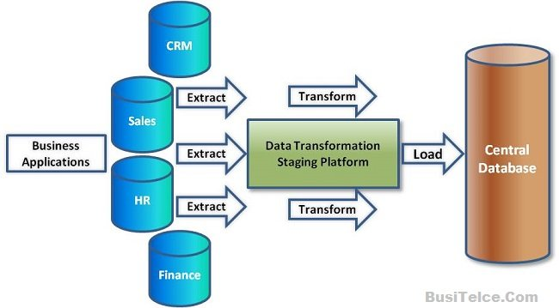
DATA WAREHOUSE

Slide 5
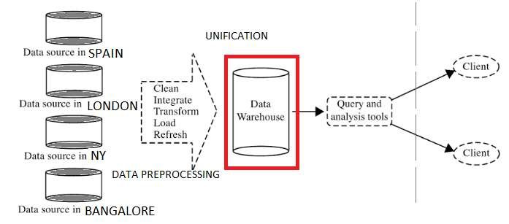

Slide 6
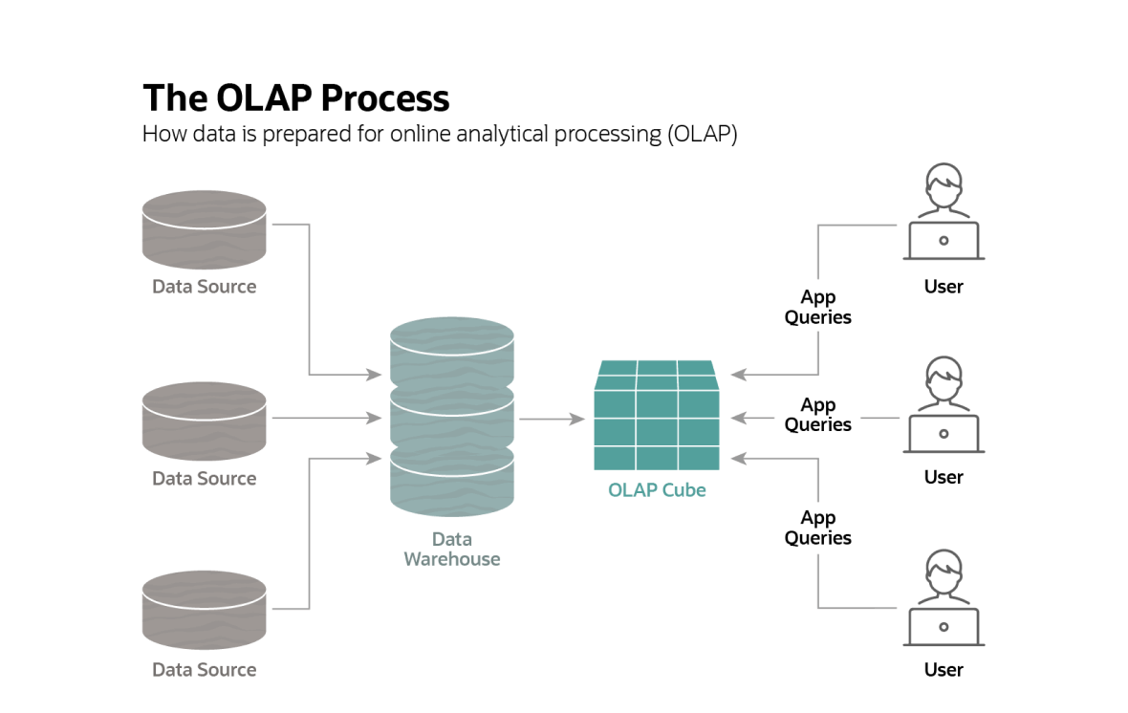
Notes:
The OLAP cube's data structure is optimized for very rapid data analysis. It includes numeric facts called measures, which are organized along a three-way axis.
For example, a company might organize its sales data by product, timeframe and location for comparative purposes. In this case, the OLAP cube's three dimensions might be product, month and store. Later, more layers can be added, creating additional dimensions. The top layer of the cube might organize sales by store, for instance, but additional layers could be added for city, state and country. Multidimensional OLAP databases with more than three dimensions are known as hypercubes.
Smaller cubes can also be carved out from the larger parent cube. The store layer, for example, could contain cubes arranged by product, month and salesperson.

Slide 7
DATA WAREHOUSE
One of the principal reasons for developing a Data Warehouse is to integrate operational data from various sources into a single and consistent architecture that supports analysis and decision making with the enterprise.
Some of the applications data warehousing can be used for are:
  Insurance fraud analysis
  Call record analysis
  Logistics management (part of Supply Chain Management that plans, implements, and controls the efficient, effective, forward, and reverse flow and storage of goods, services, and related information between the point of origin and the point of consumption in order to meet customers’ requirements)

Slide 8
DATA WAREHOUSE ADVANTAGES
More cost effective decision making: A data warehouse allows reduction of staff and computer resources required to support queries and reports against operational and production database. This typically offers significant savings.
Better enterprise intelligence: Increased quality and flexibility of enterprise analysis arises from the multi-level data structure which guarantees data accuracy and reliability ensuring that a Data Warehouse contains only “trusted” data.
Enhanced customer service: An enterprise can maintain better customer relationships by correlating all customer data via a single Data Warehouse Architecture.
Business reengineering: Allowing unlimited analysis of enterprise information often provides insights to enterprise processes that may yield breakthrough ideas for engineering those processes.Knowing what information is important to an enterprise will provide direction and priority for reengineering efforts.

Slide 9
DATA MINING
Data mining is the process of extracting hidden predictive information from a large database.
  As more data are gathered, with the amount of data doubling every year, data mining is becoming an increasingly important tool to transform this data into information.
It is commonly used in a wide range of profiling practices, such as marketing, fraud detection and scientific discovery. Data mining can be applied to data sets of any size.
Data mining tools predict future tends and behaviors, allowing businesses to make proactive, knowledge driven decisions.
Data mining sometimes called data or knowledge discovery is the process of analyzing data from different perspectives and summarizing it into useful information.
Data mining software is an analytical tool for analyzing data.
  It allows users to analyze data from many different dimensions,categorize it, and summarize the relationships identified.
Technically, data mining is the process of finding correlations or patterns among dozens of fields in large relational databases.

Slide 10
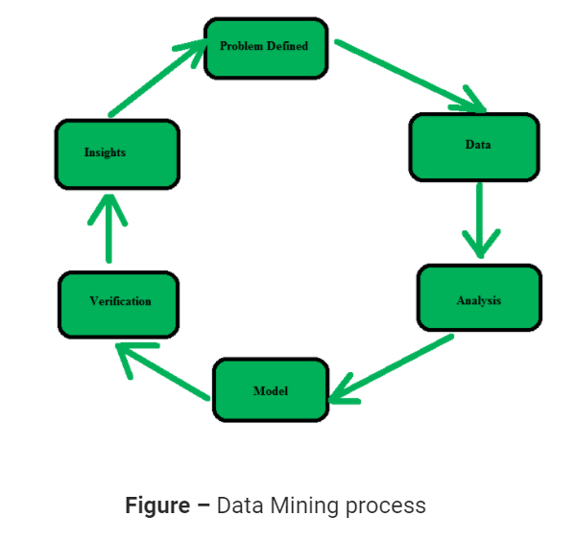
DATA MINING
It is the process of finding patterns and correlations within large data sets to identify relationships between data
Notes:
the capacity to gain an accurate and deep understanding of someone or something.
"his mind soared to previously unattainable heights of insight"

Slide 11
DATA MINING
Data mining consists of five major elements
Extract, transform, and load transaction data onto the data warehouse system.
Store and manage the data in a multidimensional database system.
Provide data access to business analysts and information technology professionals.
Analyze the data by application software.
Present the data in a useful format, such as a graph or table.

Slide 12
ADVANTAGES OF DATA MINING
Automated prediction of trends and behaviors :
  Data mining automates the process of finding predictive information in large databases.
  Questions that traditionally required extensive hands-on analysis can now be answered directly from the data, quickly.
Automated Discovery of previously unknown patterns:
  Data mining tools sweep through databases and identify previously hidden patterns in one step.
  E.g. analysis of retail sales data to identify apparently unrelated products that are often purchased together.
Database can be larger in both depth and breadth:
  The databases can have more columns and rows.
  High performance data mining allows users to explore full depth of a database, without pre-selecting a subset of variables.
  The data mining database contain larger samples (more rows) as they yield lower estimation errors and variance, and allow users to make conclusion about small but important segments of a population.

Slide 13
Difference between Data Warehousing and Data Mining
DATA WAREHOUSING | DATA MINING
A data warehouse is database system which is designed for analytical analysis instead of transactional work. | Data mining is the process of analyzing data patterns.
Data is stored periodically. | Data is analyzed regularly.
Data warehousing is the process of extracting and storing data to allow easier reporting. | Data mining is the use of pattern recognition logic to identify patterns
Data warehousing is solely carried out by engineers. | Data mining is carried by business users with the help of engineers.
Data warehousing is the process of pooling all relevant data together. | Data mining is considered as a process of extracting data from large data sets.

Slide 14
National Data Warehouses
The desire of the e-governance is to empower citizens through the access use of information.
Government always required enamors amount of data.
  Data is put to an effective use in facilitating decision-making.
A large number of national data warehouses can be identified from the existing data resources within the Central Government Ministries.
The National Data Warehouse of Official Statistics (NDWOS) is a central repository of the statistical data gathered by India’s central ministries, state governments and union territories.
By integrating disparate data sets, the National data warehouse allows researchers and policy makers to view historical data sets the same way and extract data across different groups.
Let us examine these potential subject areas on which data warehouses may be developed at present and also in future.
In 1999 the Government of India mandated the creation of the National Data Warehouse to hold all of the country’s statistical data

Slide 15
Census Data
The Registrar General and Census Commissioner of India decennially compiles information of all individuals, villages, population groups etc.
This information is wide ranging such as the individual-slip, a compilation of information of individual households, of which a database of 5% sample is maintained for analysis.
A data warehouse can be built from this database upon which Online Analytical Processing Server (OLAP) techniques can be applied.
Data mining also can be performed for analysis and knowledge discovery.
A village-level database was originally developed by National Informatics Centre at Hyderabad under General Information Services Terminal of National Informatics Centre (GISTNIC) for the 1991 Census.
This consists of two parts: primary census abstract and village amenities.

Slide 16
Census Data
Subsequently, a data warehouse was also developed for village amenities for Tamil Nadu.
This enables multidimensional analysis of the village level data in such sectors as Education, Health and Infrastructure.
As the census compilation is performed once in ten years, the data is quasi-static and, therefore, no refreshing of the warehouse needs to be done on a periodic basis.
Only the new data needs to be either appended to the data warehouse or alternatively a new data warehouse can be built.
There exist many other subject areas (e.g. migration tables) within the census purview(scope of influence) which may be amenable and appropriate for data warehouse development, OLAP and data mining applications on which work can be taken up in future.

Slide 17
Prices of Essential Commodities
The Ministry of Food and Civil Supplies, Government of India, compiles daily data (on weekly basis) for about 300 observation centers in the entire country on the prices of essential commodities such as rice, edible oils, etc.
This data is compiled at the district level by the respective State Government agencies and transmitted online to Delhi for aggregation and storage.
A data warehouse can be built for this data, and OLAP techniques can be applied for its analysis.
A data mining and forecasting technique can be applied for advance forecasting of the actual prices of these essential commodities.
The forecasting model can be strengthened for more accurate forecasting by taking into account the external factors such as rainfall, growth rate of population and inflation.

Slide 18
Other Areas for Data Warehousing and Data mining
Other possible areas for data warehousing and data mining in Central Government sectors are discussed in detail as under.

Slide 19
Agriculture
Agriculture is extremely diversified in terms of its climate, crops, horticultural crops, livestock resources, fisheries resources, plantation crops, water resources, soil etc. the diversity of its agricultural sector is both a curse and godsend to the social, economic, and cultural bases of India’s vast population.
Data mining techniques are used broadly in business and corporate sectors and be used in agriculture for data characterization, prejudice predictive and forecasting purposes
The Agricultural Census performed by the Ministry of Agriculture, Government of India, compiles a large number of agricultural parameters at the national level.
District-wise agricultural production, area and yield of crops is compiled; this can be built into a data warehouse for analysis, mining and forecasting.
Statistics on consumption of fertilizers also can be turned into a data mart.
Data on agricultural inputs such as seeds and fertilizers can also be effectively analyzed in a data warehouse.

Slide 20
Agriculture
Data from livestock census can be turned into a data warehouse.
Data gives information like livestock, seeds, fertilizer, agricultural land, and machineries etc. collecting large amounts of data often is both a blessing and a curse.
There is a lot of data available containing information about certain asset. Here soil and acquiesce properties, which should be used to the farmers advantage.
Land-use pattern statistics can also be analyzed in a warehousing environment.
Other data such as watershed details and also agricultural credit data can be effectively used for analysis by applying the technologies of OLAP and data mining.
Data mining techniques aim at finding those patterns or information in the data that are both valuable and interesting to the farmer
Thus there is Substantial scope for application of data warehousing and data mining techniques in Agricultural sector.
Government provide facilities to the farmers and other people on the basis of information

Slide 21
Rural Development
Data on individuals Below Poverty Line (BPL survey) can be built into a data warehouse.
Drinking water census data (from Drinking Water Mission) can be effectively utilized by OLAP and data mining technologies.
Monitoring and analysis of progress made on implementation of rural development programs can also be made using OLAP and data mining techniques.

Slide 22
Health
Data mining applications can greatly benefit for all parties concerned in the healthcare industry.
Data mining can help healthcare insurers detect fraud and mistreatment healthcare organizations make customer relationship management decisions, physicians identify effective treatments and best practices, and patients receive better and more affordable healthcare services.
Information is crucial for effective management and development of health services and therefore is an important tool.
A Health Information System is mainly required to support management and operations at three levels: namely transactional and functional; operational control; planning (strategic and management)
Community needs assessment data, immunization data, data from national programs on controlling blindness, leprosy, malaria can all be used for data warehousing implementation, OLAP and data mining applications.

Slide 23
Health
It can also identify clinical best practices to help develop guidelines and standards of care.
Data Mining is helpful in healthcare.
  Patients can receive better, more inexpensive healthcare services.
  Healthcare organizations can use data mining to make improved patient-associated decisions.
  Insurers can become aware of medical insurance scam and mistreatment through data mining by establishing norms and then identifying unusual claims patterns.
  Healthcare organizations under increasing financial pressure, data mining can also influence revenues, costs, and operating efficiency while maintaining high-quality care.
  It can also recognize clinical paramount practices to help develop guidelines and standards of care.
  Some Data mining Application in health care are: Treatment Effectiveness, Health care management, Customer relationship, Fraud and Abuse

Slide 24
Planning
Planning (also called preparation) is the process of thoughts about and organizing the behavior required to accomplish a desired goal.
Data mining is the process of searching data for previously unknown patterns and using those patterns to predict prospect outcomes. “Data Mining”, often also known as “Knowledge Discovery in Databases”,
At the Planning Commission, data warehouses can be built for state plan data on all sectors: labor, energy, education, trade and industry, five year plan, etc.
Data mining and predictive analytics are proven technologies that have become an integral part of the daily operations of leading organizations.
Data mining is the process of uncovering patterns in data using predictive techniques.
These patterns improve decision making by providing the actionable insight needed to improve business processes helping organizations achieve critical business goals.

Slide 25
Education
Data mining is a powerful tool for academic intervention.
Data Mining is used to extract meaningful information.
Education is a necessary constituent for the success of country.
In Data mining in learning environment is called educational data mining.
Education is a vital part for the betterment and progress of a country.
Educational data mining is emerging as a research area with a suite of computational and psychological methods and research approaches for understanding how students learn
The Sixth All India Educational Survey data has been converted into a data warehouse (with about 3 GB of data).
Various types of analytical queries and reports can be answered.
New computer-supported interactive learning methods and tools—intelligent tutoring systems, simulations, games have opened up opportunities to collect and analyze student data, to discover patterns and trends in those data, and to make new discoveries and test hypotheses about how students learn.

Slide 26
Education
Data composed from online learning systems can be aggregated over large numbers of students and can contain many variables that data mining algorithms can explore for model building.
Predicting students’ future learning behavior by creating student models that incorporate such detailed information as students’ knowledge, motivation, meta cognition, and attitudes.
Discovering or improving domain models that characterize the content to be learned and optimal instructional sequences.
Studying the effects of different kinds of pedagogical support that can be provided by learning software.
Advancing scientific knowledge about learning and learners through building computational models that incorporate models of the student, the domain, and the software’s pedagogy.

Slide 27
Commerce and Trade
Commerce is the Exchange of goods or services for money or in kind, usually on a scale large enough to require transportation from place to place or across city, state, or national boundaries.
Perception commerce is being analyzed based on four perspectives: communication, business processes, services, and real-time accessibility.
Data bank on trade (imports and expo11s) can be analyzed and converted into a data warehouse.
World price monitoring system can be made to perform better by using data warehousing and data mining technologies.
Provisional estimates of import and export also be made more accurate using forecasting techniques.

Slide 28
Other Sectors
In addition to the above mentioned important applications, there exist a number of other potential application areas for data warehousing and data mining, as follows:
Tourism.
  Tourist arrival behavior and preferences; tourism products data; foreign exchange earnings data; and Hotels, Travel and Transportation data.
Program Implementation.
  Central projects data (for monitoring).
Revenue.
  Revenue plays a significant role in a business growth without the support of Revenue any business cannot make a profit and stay feasible in the long run.
  Customs data, central excise data, and commercial taxes data(state government)

Slide 29
Other Sectors
Economic affairs.
  Budget and expenditure data; and annual economic survey.
Audit and accounts.
  Government accounts data.
All government departments or organizations are deeply involved in generating and processing a large amount of data.
Conventionally, the government departments have largely been satisfied with developing single management information systems (MIS), or in limited cases, a few databases which were used online for limited reporting purposes.
Much of the analysis work was done manually by the Department of Statistics in the Central Government or in any State Government.
The techniques used for analysis were conventional statistical techniques on largely batch-mode processing.

Slide 30
Other Sectors
Prior to the advent of data warehousing and data mining technologies nobody was aware of any better techniques for this activity.
In fact, data warehousing and data mining technologies could lead to the most significant advancements in the government functioning, if properly applied and used in the government activities.
With their advent and prominence, there is a paradigm shift which may finally result in improved governance and better planning by better utilization of data.
Instead of the officials wasting their time in processing data, they can rely on data warehousing and data mining technologies for their day to-day decision making and concentrate more on the practical implementation of the decisions so taken for better performance of developmental activities.

Slide 31
Other Sectors
Further, even though various departments in the government (State or Central) are functionally interlinked, the data is presently generated, maintained and used independently in each department.
This leads to poor (independent) decision making and isolated planning.
Herein lies the importance of data warehousing technology.
  Different data marts for separate departments, if built, can be integrated into one data warehouse for the government.
This is true for State Government and Central Government.
Thus data warehouses can be built at Central level, State level and also at District level.

